Slide 1
Basic Application Software
3
Chapter 3

Slide 2
Learning Outcomes
Identify general-purpose applications
Describe word processors, spreadsheets, presentation programs, and database management systems.
Identify specialized applications.
Describe graphics programs, web authoring programs, and other specialized professional applications.
Describe mobile apps and app stores.
Identify software suites.
Describe office suites, cloud suites, specialized suites, and utility suites.

Slide 3

Introduction
Not long ago, trained specialists were required to perform many of the operations you can now do with a personal computer.
Competent end users need to understand the capabilities of basic application software including:
Word processors
Spreadsheets
Presentation programs
Database management systems
Notes:
Personal computer can be thought of as an electronic tool.

Slide 4
Application Software
Application software
End user software
Accomplish a variety of tasks
Three categories
General Purpose Applications
Specialized Applications
Mobile Apps
Notes:
Two kinds of software (as discussed in Chapter 1)
System software (Key Term) – works with end users, application software, and computer hardware to handle the majority of technical details
Application Software (Key Term) – is end user software that is used to accomplish a variety of tasks
Three categories of Application Software
General Purpose Applications (Key Term) – word processing, spreadsheets, presentation graphics and database management systems.
Specialized Applications (Key Term) – tend to be more focused and used in specific areas and disciplines
Mobile Apps (key Term) – add-on features or programs designed for mobile devices such as smartphones and tablets.

Slide 5
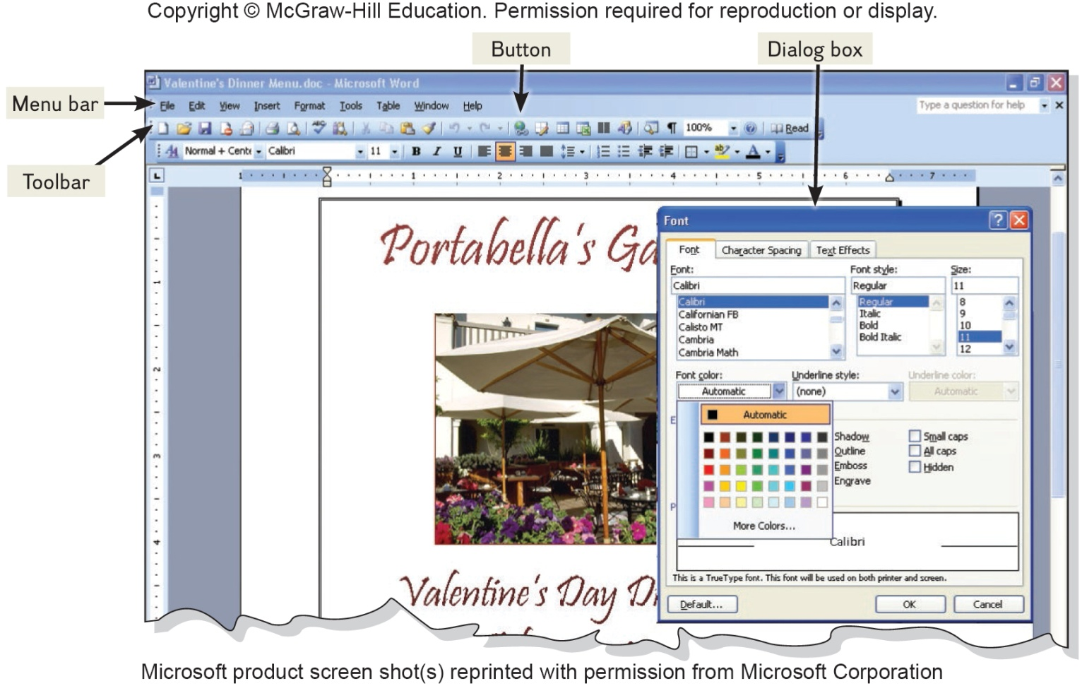
User Interface
Graphical User Interface (GUI) consists of:
Icons
Pointer
Windows
Menus
Toolbars
Buttons
Dialog Boxes
Notes:
User interface (key term) or Graphical User Interface (GUI) (key terms) allows the user to control and interact with the program.
Graphical elements called Icons (key term) can be clicked on by the user using the mouse.
The mouse controls the pointer (key term) on the screen to select the icon
Once the icon is selected and clicked, the represented program will display in the window (key term) which is the rectangular area containing a document, program or message.
Most programs use a system of menus, toolbars, and dialog boxes.
Menus (key term) present commands that are displays in the menu bar at the top of the screen
Toolbars (key term) appear below the menu bar (key term) and include graphic elements known a buttons (key term) the user can click on as a shortcut
Dialog Boxes (key term) provide additional information and request user input

Slide 6
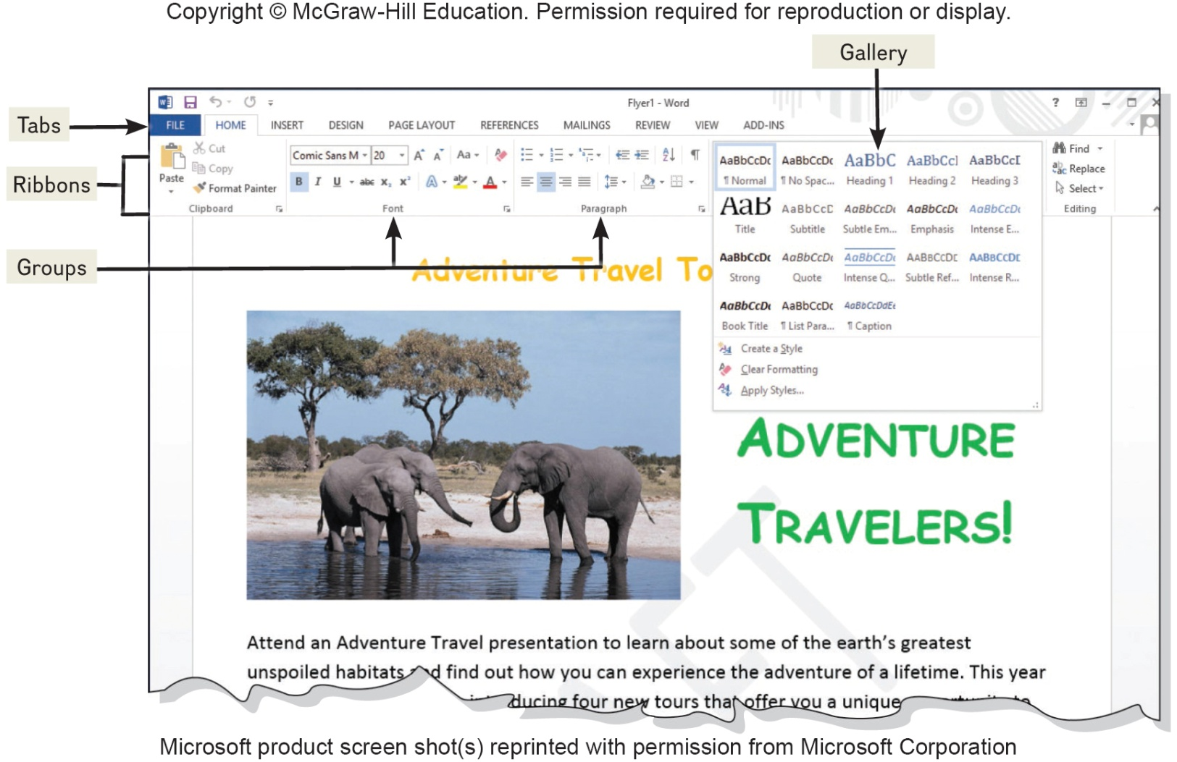
Common Features in Microsoft
Ribbon GUI
Ribbons
Tabs
Groups
Contextual tabs
Galleries
Spell checkers
Alignment
Font and Font Sizes
Tables
Reports
Notes:
Ribbon GUI (key term) makes it easier for the user to find and use all the features of an application
Ribbons (key term) replace menus and toolbars using commands into a set of tabs
Tabs (key term) divide the ribbon into major categories. Each tab represents groups (key term) of related items.
Contextual tabs (key term) are only used when the item is selected and at that time, operations can be performed on that item.
Galleries (key term) give the user to see the effect their selection will have prior to making their choice.
Most applications provide us with some variety of things such as
Spell Check
Alignment
Font and Font Sizes
Tables
Reports

Slide 7
General Purpose Applications
General purpose applications include:
Word processor programs
Spreadsheet programs
Presentation graphics programs
Database management systems

Slide 8
Word Processor Programs
Create text-based documents
Memos, letters, and faxes
Newsletters, manuals, and brochures
Word processing programs
Microsoft Word
Most popular
Apple Pages
Google Docs
Corel WordPerfect
OpenOffice Writer
Notes:
Word Processor Programs (key term)
One of the most flexible and widely used software tools used to create documents (key term)
One of the first programs used by PC end-users
Microsoft Word is the most used word processor programs

Slide 9

Creating a Flyer
Flyer Features
Spell Checker
Center-alignment
Grammar Checker
Fonts
Font Sizes
Word Wrap
Character Effects
Notes:
Flyer Features
Spelling Checker
Center-Aligning
Grammar checker
Fonts
Font Sizes
Word Wrap
Character Effects
You have been asked to create a promotional advertising flyer. After discussing the flyer’s contents and basic structure with your supervisor, you start to enter the flyer’s text. As you enter the text, the spelling checker and grammar checker catch some spelling and grammatical errors. Once the text has been entered, you proofread the text and then focus your attention on enhancing the visual aspects of the flyer. You add a photograph and experiment with different character and paragraph formats, including fonts, font sizes, colors, and alignments.

Slide 10
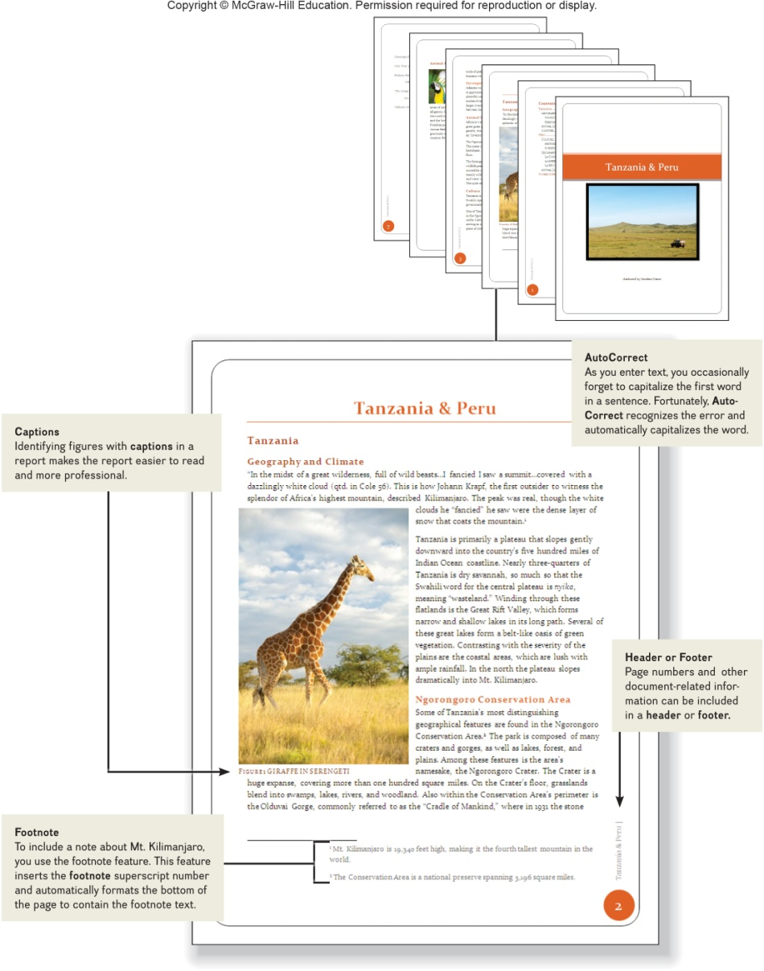
Creating a Report
Report Features
AutoCorrect
Footnote
Header or Footer
Captions and Cross References
Tables
Notes:
Report features
AutoCorrect
Footnote
Header or footer
Captions and cross references
Tables
Your next assignment is to create a report on Tanzanla and Peru. After conducting your research, you start writing your paper. As you enter the text for the report, you notice that the AutoCorrect feature automatically corrects some grammar and punctuation errors. Your report includes several figures and tables. You use the captions feature to keep track of figure and table numbers, to enter the caption text, and to position the captions. You use the footnote feature to assist in adding notes to further explain or comment on information in the report. Finally, you prepare the report for printing by adding header and footer information.

Slide 11
Spreadsheet Programs
Organize, analyze, and graph numeric data
Spreadsheet programs
Microsoft Excel
Most widely used
Apple Numbers
OpenOffice Calc
Corel Quattro Pro
Google Sheets
Notes:
Spreadsheet program (key term)
Organize, analyze and graph numeric data such as budgets and financial reports
The most widely used in Microsoft Excel. Other spreadsheet applications include Apple Numbers and OpenOffice Calc.

Slide 12
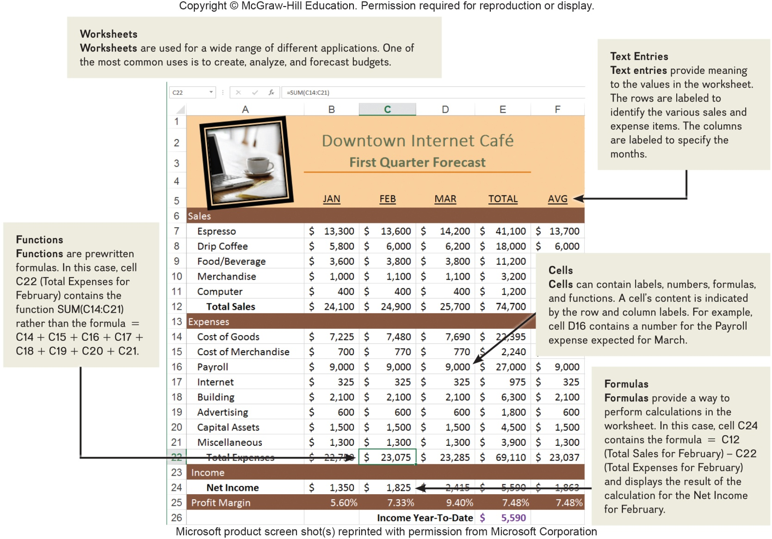
Creating a Sales Forecast
Features
Worksheets
Text entries
Functions
Cells
Formulas
Notes:
Features
Worksheets
Text entries
Functions
Cells
Formulas
Your first project is to develop a first-quarter sales forecast for the café. You begin by studying sales data and talking with several managers. After obtaining sales and expense estimates, you are ready to create the first-quarter forecast. You start structuring the worksheet by inserting descriptive text entries for the row ad column headings. Next, you insert numeric entries, including formulas and functions to perform calculations. To test the accuracy of the worksheet, you change the values in some cells and compare the recalculated spreadsheet results with hand calculations.

Slide 13
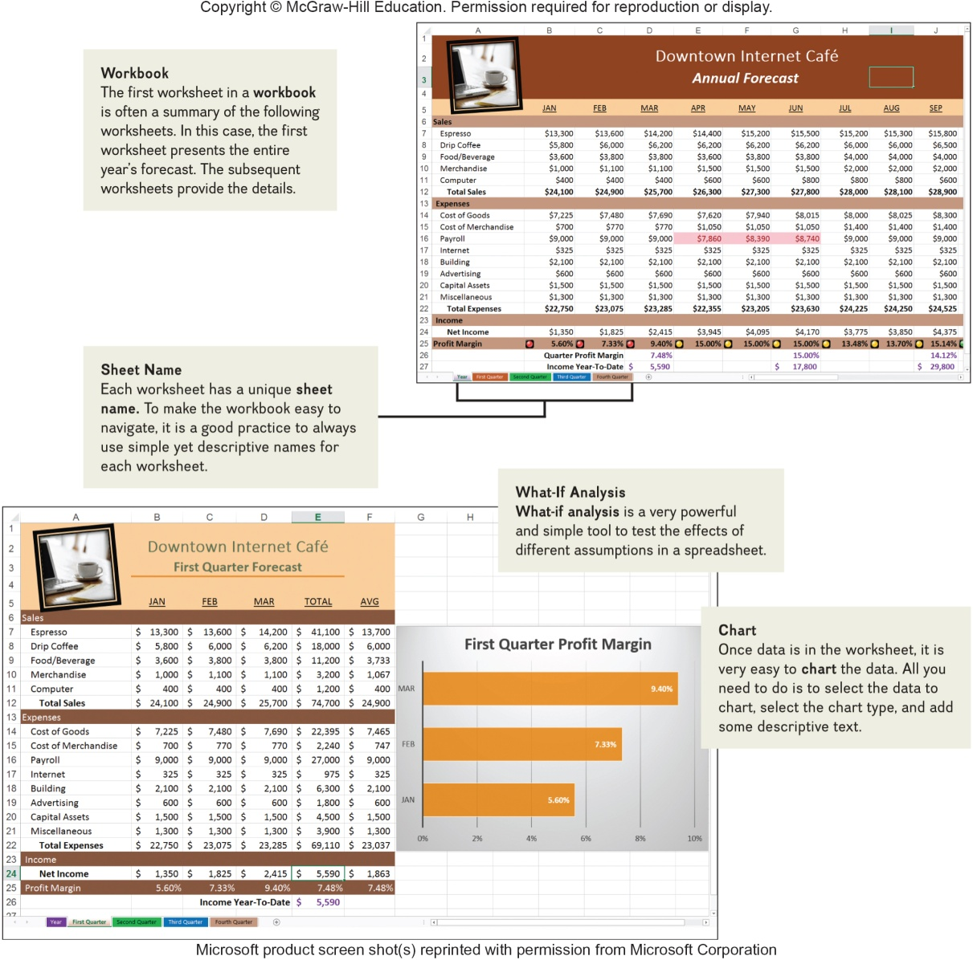
Analyzing Your Data
Analysis Features
Workbook and worksheets
What-if Analysis
Notes:
Features
Workbook and worksheets
What-if analysis
After presenting the First-Quarter Forecast to the owner, you revise the format and expand the workbook to include worksheets for each quarter and an annual forecast summary. You give each worksheet a descriptive sheet name. At the request of the owner, you perform a what-if analysis to test the effect of different estimates for payroll, and you use chart to visualize the effect.

Slide 14
Presentation Graphics Programs
Combine a variety of visual objects to create visually interesting presentations
Presentation programs
Microsoft PowerPoint
OpenOffice Impress
Apple Keynote
Google Slides
Corel Presentations
Notes:
Presentation graphics program (key term)
Creates interesting and professional presentations

Slide 15
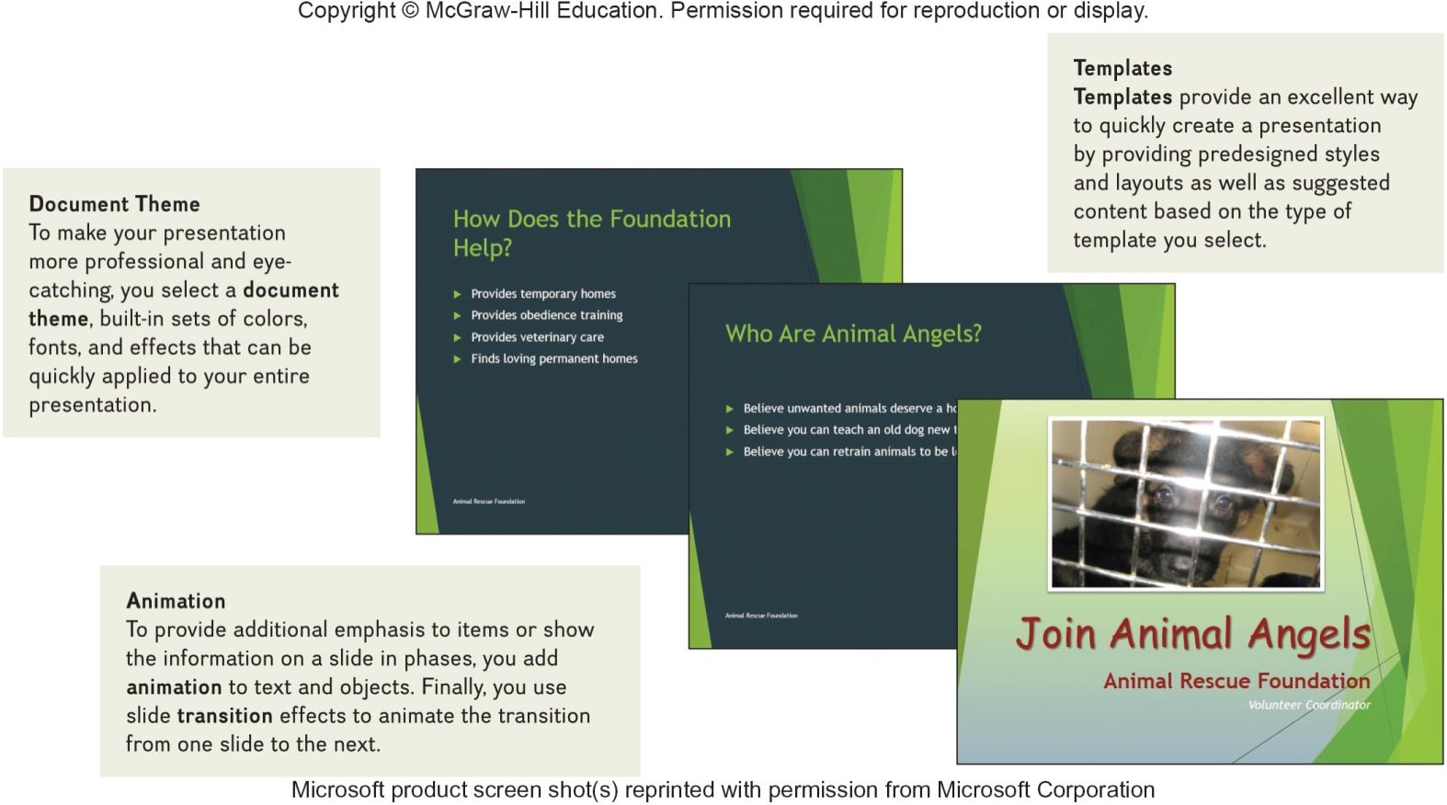
Creating a Presentation
Presentation Features
Document Theme
Animation
Templates
Notes:
Document Theme (key term) make your presentation more professional and eye catching
Animation (key term) to provide additional emphasis on items or show the information on a slide
Templates (ley term) provides predesigned styles and layouts to quickly create a presentation
You have been asked to crate a powerful and persuasive presentation for the director of the foundation designed to encourage other members from your community to volunteer. The first step is to meet with the director of the foundation to determine the content of the presentation. Then using PowerPoint, you begin creating the presentation by selecting a presentation template and document theme. After entering the content, you add interest to the presentation by adding animation to selected objects and using slide transition effects.

Slide 16
Database Management Systems (DBMS)
A collection of related data
Electronic equivalent of a file cabinet
Two most widely used systems
Microsoft Access
OpenOffice Base
Apple FileMaker
Google Obvibase
Notes:
Database (key term) is a collection of related data
Database Management Systems (DBMS) (key term) or a Database Manager (key term) – program that sets up or structures a database
Establishes a structure for data storage, usually relational – using related tables, so related data can be easily retrieved

Slide 17
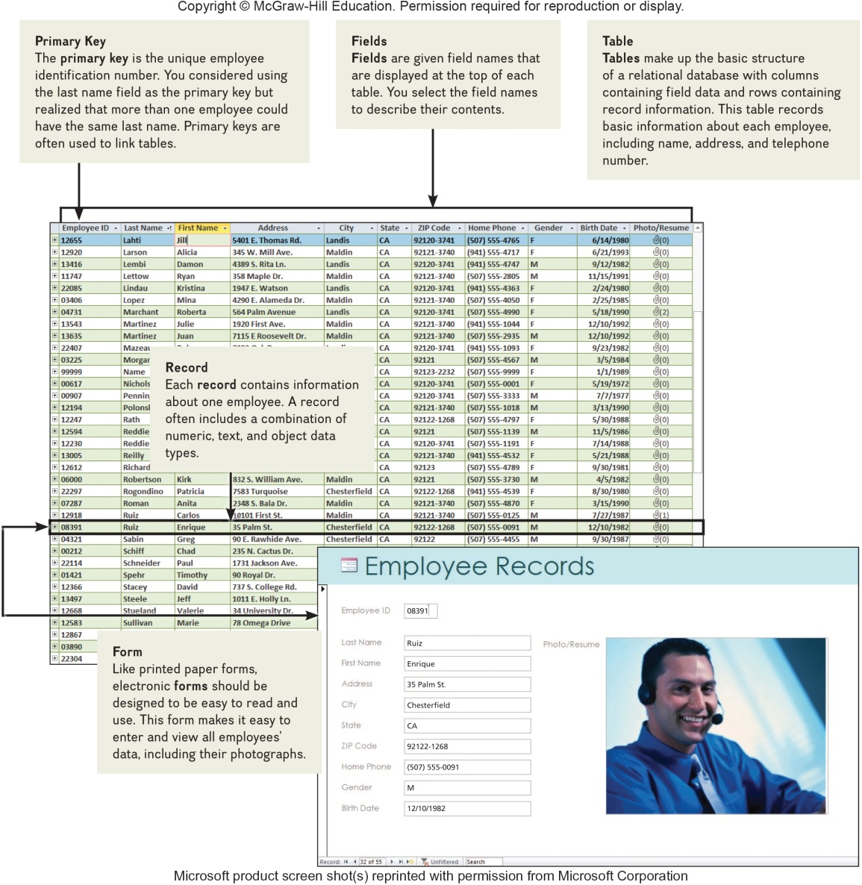
Creating a Database
First steps is to plan
Database Features
Primary Key
Fields
Record
Table
Form
Notes:
The first step is to plan the database
Features
Primary key
Fields
Record
Table
Form
You have been asked to create an employee database to replace the club’s manual system for recording employee data. The first step in creating the database management system is to plan. You study the existing manual system focusing o how and what data is collected and how it is used. Next, using Microsoft Access, one of the most widely used DBMS programs, you design the basic structure or organization of the new database system to include a table that will make entering data and using the database more efficient. You create the table structure by specifying the fields and primary key field. To make the process faster and more accurate, you create a form and enter the data for each employee as a record in the table.

Slide 18
Specialized Applications
Programs that more narrowly focused on specific disciplines and occupations
Includes:
Graphics Programs
Web Authoring Programs
Notes:
Specialized applications included graphics programs and web authoring programs.

Slide 19
Graphics Programs
Widely used in graphic arts
Types of graphics programs are:
Desktop Publishing Programs
Image Editing Programs
Illustration Programs
Image Galleries

Slide 20
Desktop Publishing Programs
Also known as Page Layout Programs
Mix text and graphics to create brochures, newsletters, newspapers and textbooks
Popular programs:
Adobe InDesign
Microsoft Publisher
QuarkXPress
Notes:
Desktop publishing programs (key term) or page layout programs (key term) give the graphic artist the ability to combine text and graphics.
The major focus is on page design and layout and desktop publishing programs lend greater flexibility to this feature.
Many of the elements used in desktop publishing are actually imported from other sources such as word processors, digital cameras, scanners, image editors, illustration programs and image galleries.

Slide 21
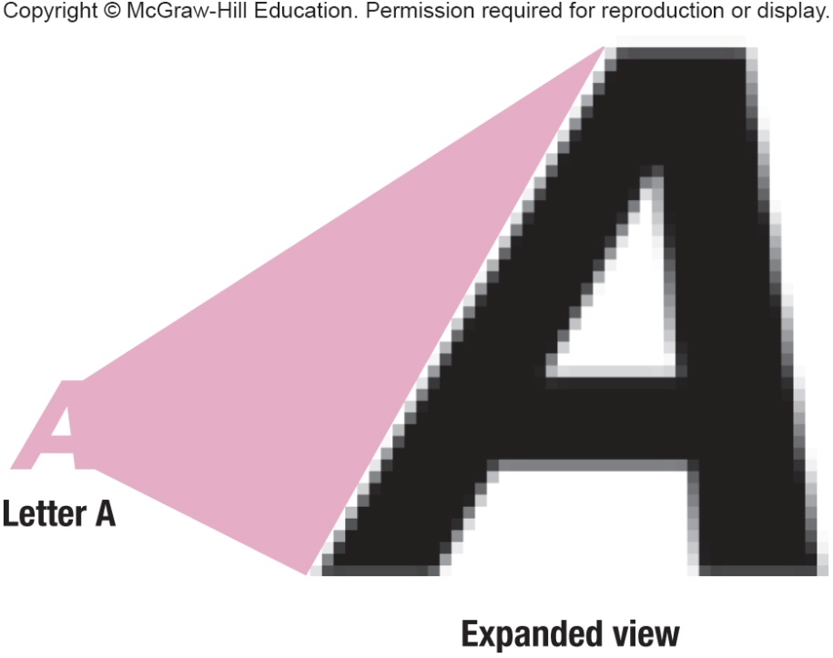
Image Editors
Also know as Photo Editors
Editing or modifying digital photographs
Photographs consist of thousands of pixels that form images knows as bitmaps
Popular image editors
Adobe Photoshop
Corel PaintShop Pro
GIMP (GNU Manipulation Program)
Windows Live Photo Gallery
Notes:
Photo Editors (key term) or Image editors (key term) are used for editing or modifying photographs.
Often it is desired to touch up a photograph or remove scratches or imperfections.
The photograph is made of up thousands of dots or pixels (key term), they form an image referred to as a bitmap (key term) or a raster (key term) image.
If a bitmap is over adjusted it suffers from being pixelated or jagged on the edges.

Slide 22
Illustration Programs
Drawing programs
Create and edit vector images
Vector illustrations
Geometric shapes or objects
Created by connecting lines and curves
Defined by mathematical equations
Popular Illustration Programs
Adobe Illustrator
CorelDraw
Inkscape
Notes:
Illustration programs (key term) also know as drawing programs (key term) create vector images (key term) which differ from bitmap images.
Vector images (key term) or vector illustrations (key term) are made up of geometric shapes or objects created by connecting lines and curves defined by mathematical equations. This makes their editing quick and resizing, coloring, texturing and manipulation easy.

Slide 23
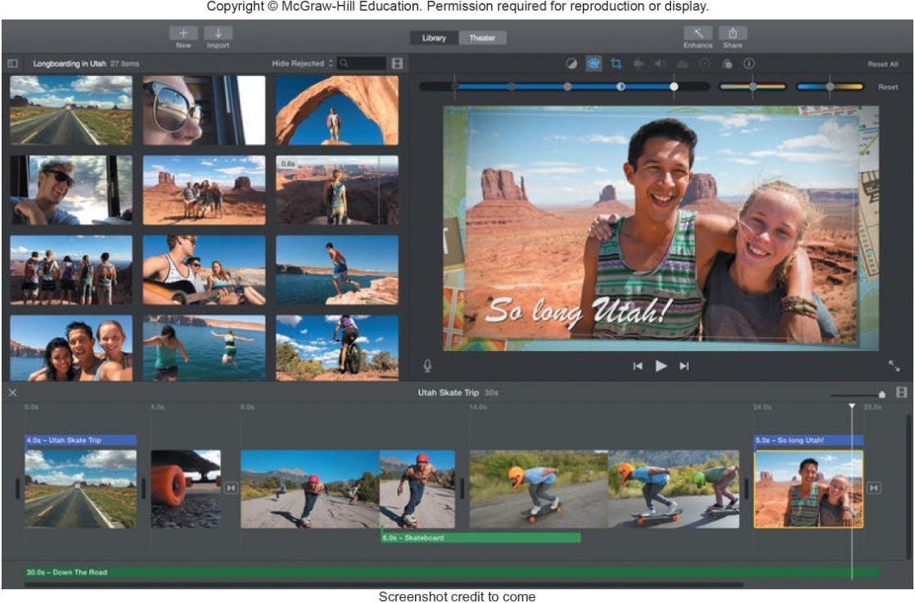
Video Editors
Edit videos to enhance quality and appearance
Can now use your smartphone to edit videos
Well-known programs
Windows Live Movie Maker
Apple iMovie
YouTube Video Editor
Notes:
Video Editors edit videos to enhance quality and appearance
Can now use your smartphone or tablet to edit videos
Three well-known video editor programs
Windows Live Movie Maker
Apple iMovie
YouTube Video Editor

Slide 24
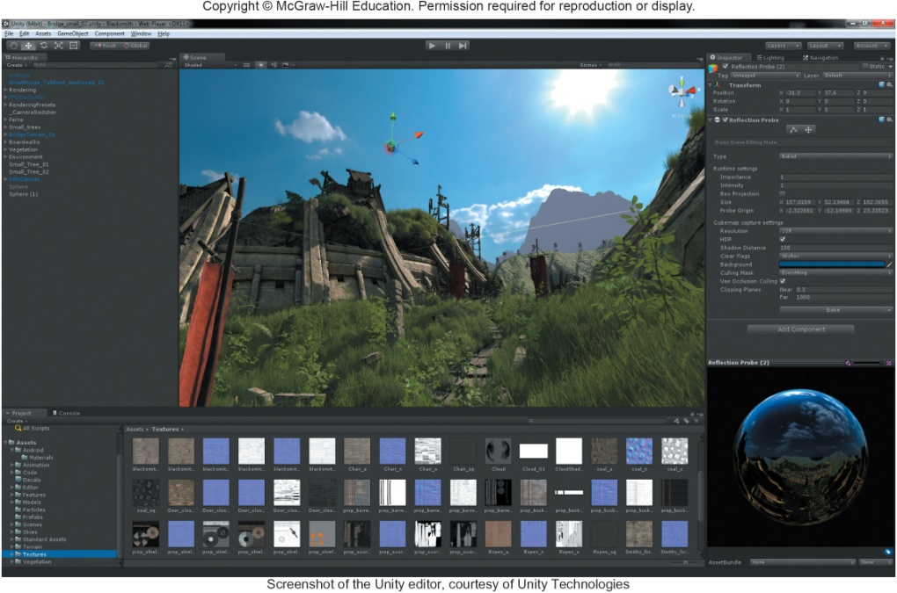
Video Game Design Software
Video Game Design Software helps
Organize thoughts
Guide user through game design process
Character development
Environmental design
Free / inexpensive video game design software
YoYo GameMaker
Stencyl
Unity

Slide 25
Web Authoring Programs
Web authoring is the creation of a site
Design
Document file displaying website’s content
Blog
Online diary/commentaries
Web Authoring Programs
Typically used to create commercial sites
Web page editors or HTML editors
WYSIWYG (what you see is what you get)
Most widely used programs
Adobe Dreamweaver
Microsoft Expression Web
Notes:
There are over a billion websites on the Internet and more being created and added as we speak.
Anything from corporations promoting their products to individuals creating online diaries or blogs (key term).
It all begins with web authoring (key term) or the creation of a site through a Web Authoring program (key term).
It starts with the design and then the document file displaying the website’s content.
Some web authoring programs are WYSIWYG (key term) what you see is what you get which means you can build the page without having to interact or understand coding (HTML)
Web page editors (key term) or HTML editors (key term) provide support for website design and HTML coding

Slide 26

Mobile Apps
Mobile Applications or Mobile Apps
Add-on programs for a variety of mobile devices
Smartphones or tablets
Apps
Breadth and scope are ever-expanding
500,000 just for iPhone
Music, videos, social networking, shopping, games
Notes:
Mobile Apps (key term) or mobile applications (key term) are add-on programs that can be downloaded from App Stores for your smartphone or tablet.
Apps
There are over 500,000 apps for Apple iPhone alone.
Most popular are:
Music
Video
Social Networking
Shopping
Games
App Stores (key term)
Provide access to mobile apps either for free or a fee

Slide 27
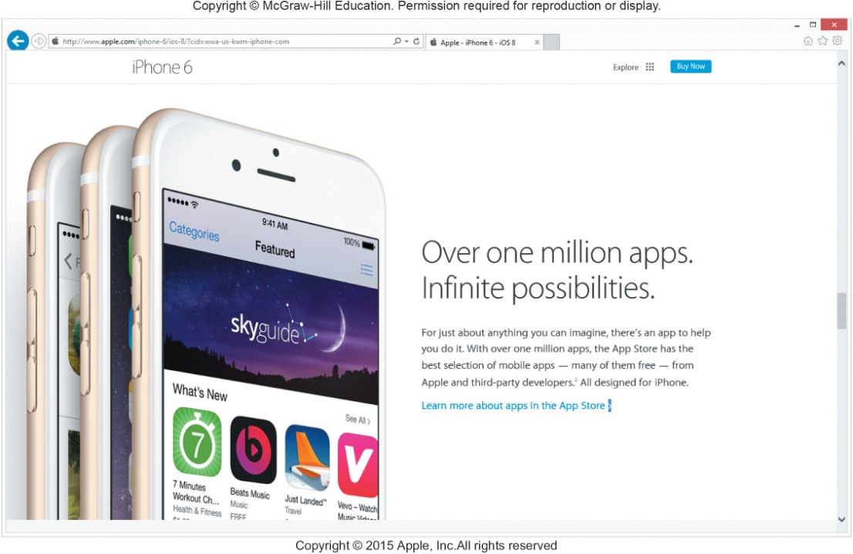
App Stores
App Stores
Provides access to mobile apps for downloads
Apple’s App Store
Apple Devices
www.apple.com/itunes/charts
Google Play
Andriod Devices
Play.google.com/store/apps
Appszoom
Andriod and Apple Devices
www.appszoom.com
Notes:
App Stores (key term)
Provide access to mobile apps either for free or a fee
Most popular
Apple’s App Store
Google Play
Appszoom

Slide 28
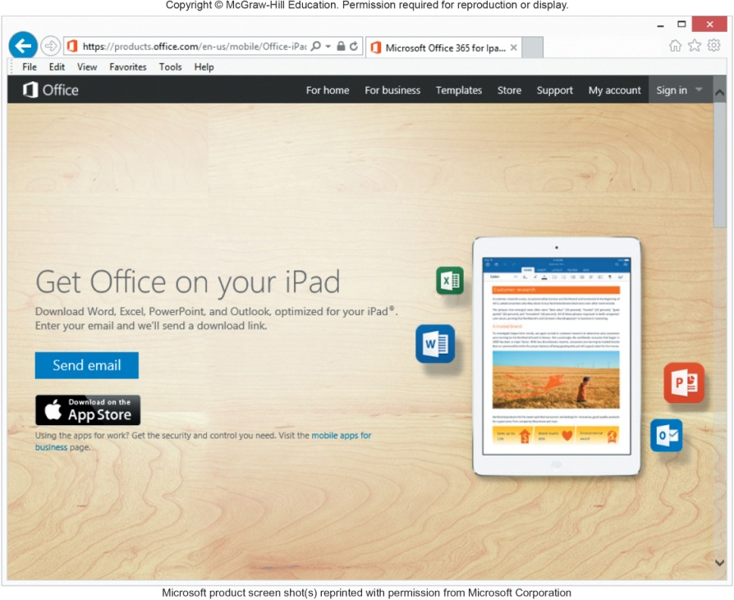
Software Suites
Collection of separate application programs
Bundled together – sold as group
Four types of suites
Office suites or office software suite / productivity suites
Microsoft Office
Apple iWork, OpenOffice
Cloud suites or online office suites
Google Docs (Making IT Work for You), Zoho, Microsoft Office 365
Notes:
Office Software Suite (ley term) / Office Suite (key term) / Productivity Suite (key term)
A collection of separate applications bundled and sold as a group that share information between applications
Less expensive than individual applications; but more expensive than integrated packages
Cloud Suites (key term) or online office suites (key term) are stored at a server on the Internet and access is gained through the Internet.
Ease in collaboration
Downside – dependent on server so be sure to have a backup

Slide 29
Suites continued
Specialized suites
Focus on specific applications
Corel Draw Graphics Suite X6
Moneyfree Software TOTAL Planning Suite
Utility suites
Designed to make computing easier and safer
Norton Systems Works
Norton Internet Security suite
Notes:
Specialized suites (key term) include graphics or financial suites among others. The most popular are CorelDraw Graphics Suite X6 and Moneyfree Software TOTAL Planning Suite.
Utility suites (key term) are designed to make computing safer for all.

Slide 30
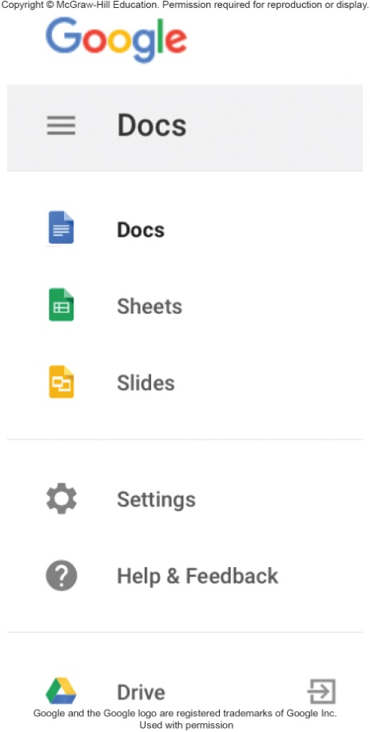
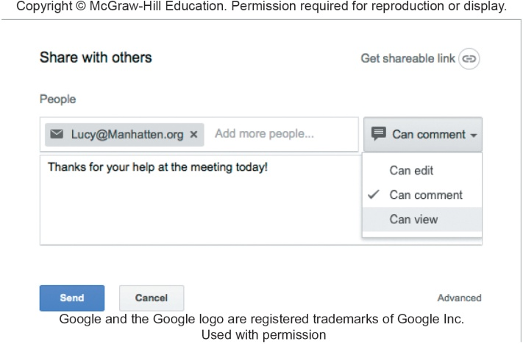
Making IT Work for You - Google Docs
Tool to create and collaborate with others
Creating /sharing documents
Free and easy to use
Free Google account
Free online storage
Notes:
Page 78 in your text.

Slide 31

Careers In IT
Software Engineers
Analyze users’ needs and create application software
Attributes
Good communication and analytical skills
Programming experience
Detail oriented
Web application experience
Analytical skills
Earning potential of $55,000 to $71,000 annually
Notes:
Software Engineers (key term) analyze users’ needs and create application software.
Typically have experience in programming but focus on the design and development of programs using the principles of mathematics and engineering.

Slide 32

A Look to the Future
Next-Generation User Interfaces
Doubtful a single interface will serve everyone
Must be comfortable to use
Touch / interactive screen
Voice recognition
Gestures
Augmented Reality

Slide 33
Open-Ended Questions (Page 1 of 2)
Explain the difference between general-purpose and specialized applications. Also discuss the common features of application programs, including those with traditional and ribbon graphical user interfaces.
Discuss general-purpose applications including word processors, spreadsheets, database management systems, and presentation graphics.
Notes:
Have students turn to the end of Chapter 3 in their textbooks to view the same “Open-Ended” questions/statements

Slide 34
Open-Ended Questions (Page 2 of 2)
Discuss specialized applications, including graphics programs, video game design software, web authoring programs, and other professional specialized applications
Describe mobile apps, including popular apps and app stores.
Describe software suites, including office suites, cloud suites, specialized suites, and utility suites.
Notes:
Have students turn to the end of Chapter 3 in their textbooks to view the same “Open-Ended” questions/statements

